Slide 1



Automating Excel Reports with Python
Tired of repetitive tasks in Excel? Python can automate your reports, saving you time and reducing errors. This project leverages Python to simplify and automate Excel tasks, making it accessible even for those who are not technically inclined.

Slide 2

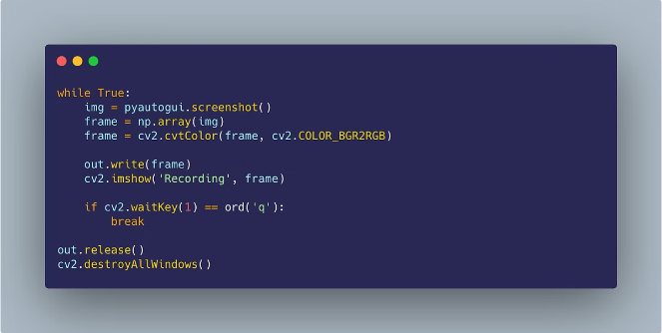
Introduction to Excel Automation
Excel automation involves using programming languages like Python to interact with Excel spreadsheets. This allows you to perform actions like data manipulation, report generation, and analysis automatically.
1
Efficiency
Automating tasks reduces manual effort, freeing up time for more strategic work.
2
Accuracy
Eliminates human errors by ensuring consistent and accurate data processing.
3
Scalability
Automate tasks that would be tedious or impossible to perform manually, handling large datasets.
4
Flexibility
Python allows you to customize automation workflows to fit specific business needs.

Slide 3
Why Automate Excel Reports?
Manual Excel report creation is time-consuming, prone to errors, and lacks flexibility. Automation empowers businesses to generate accurate, timely, and customized reports.
Faster Turnaround
Reduced Errors
Enhanced Flexibility
Generate reports in seconds instead of hours, improving decision-making speed.
Eliminate manual data calculations, ensuring accuracy and consistency.
Create dynamic reports that adapt to changing data and business requirements.

Slide 4




Python: The Powerful Tool for Automation
Python's readability, extensive libraries, and robust community support make it ideal for automating tasks. Libraries like Pandas and Openpyxl provide tools for interacting with Excel files.
Data Manipulation
Report Generation
Clean, transform, and analyze data efficiently using Pandas.
Create visually appealing reports with formatted tables, charts, and graphs.
Task Scheduling
Data Visualization
Use libraries like schedule to automate tasks on a regular basis.
Generate insightful charts and visualizations using libraries like Matplotlib and Seaborn.

Slide 5

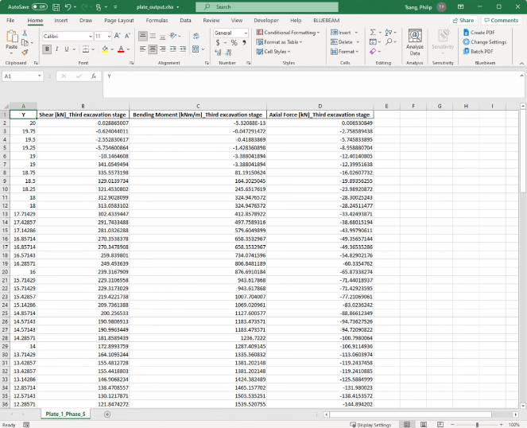
Integrating Python with Excel
Python libraries like Openpyxl provide functions to read, write, and manipulate data in Excel files. You can access and modify cells, format data, and create new worksheets.
1
Install Libraries
Use pip to install necessary libraries like Openpyxl and Pandas.
2
Connect to Excel
Use Openpyxl to open and work with existing Excel files or create new ones.
3
Get Summary Statistics
Using Python describe function to display the statistics of the dataset uploaded to the app.
4
Generate Reports
Create visually appealing reports with formatted tables, charts, and graphs.

Slide 6

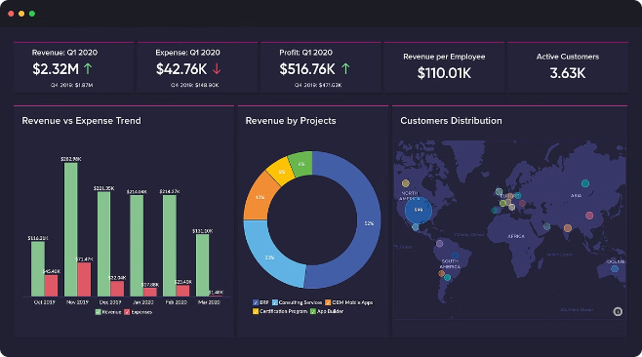
Extracting and Manipulating Data
Python libraries like Pandas allow you to extract, manipulate, and analyze data from Excel files. You can filter, sort, aggregate, and transform data for reporting purposes.
Data Extraction
Read data from Excel sheets into Pandas DataFrames for easy manipulation.
Data Cleaning
Handle missing values, convert data types, and remove duplicates for accurate reporting.
Data Transformation
Aggregate data, calculate summary statistics, and perform other data transformations.

Slide 7
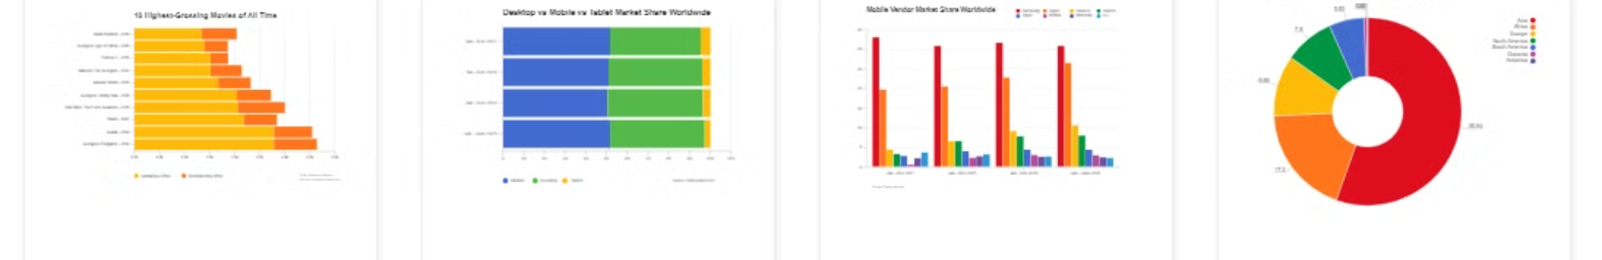
Generating Dynamic Reports
Python allows you to create dynamic reports that adapt to changing data. You can generate charts, tables, and other visual elements based on your data.
Feature
Description
Data-driven
Reports automatically update based on changes in the source data.
Customizable
Design reports with specific layouts, formatting, and visualizations.
Interactive
Create reports with interactive elements like filters and drilldowns.

Slide 8
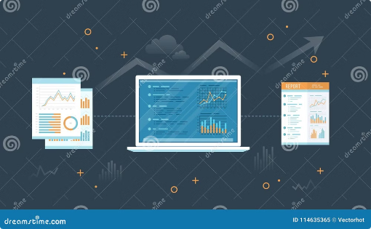
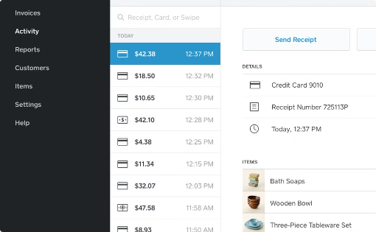
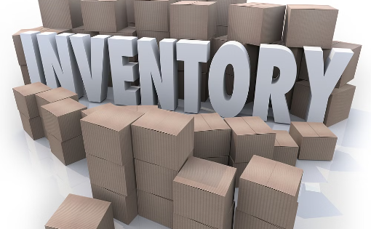
Real-World Applications of Excel Automation
Python automation of Excel reports is used across various industries to streamline processes and improve decision-making. Examples include financial reporting, sales analysis, and inventory management.
Financial Reporting
Sales Analysis
Inventory Management
Generate monthly financial statements, balance sheets, and profit and loss reports.
Analyze sales data to identify trends, track performance, and forecast future sales.
Track inventory levels, generate purchase orders, and manage stock replenishment.

Slide 9

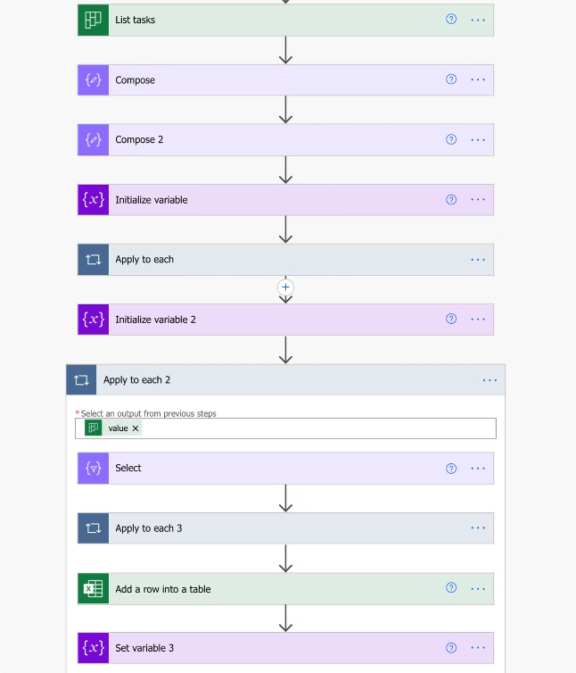
Benefits and Challenges of Excel Automation
Excel automation offers significant benefits, but there are also challenges to consider. It's important to choose the right approach and manage expectations.
1
Benefits
Increased efficiency, reduced errors, improved data quality, and better decision-making.
2
Challenges
Initial setup time, technical expertise required, potential integration issues with existing systems.

Slide 10
Future Potentials
Integration with Cloud Services:
Connect to cloud databases and services for real-time data updates and save reports directly to cloud storage.
Enhanced Data Analysis:
Integrate with machine learning to provide predictive analytics and generate advanced insights from data.
Interactive Dashboards:
Develop interactive dashboards and real-time data visualizations within Excel or other platforms like Power BI.
User-Friendly Interfaces:
Create graphical user interfaces (GUIs) or web-based applications to allow users to customize and generate reports easily.
Automated Scheduling:
Implement scheduling features to automate report generation at specified intervals and send reports via email.

